Slide 1
Coordinates & Game Design

Slide 2

Navigating a Grid
Computers use numbers to represent a character’s position on screen, using number lines as rulers to measure the distance from the bottom-left corner of the screen. For our videogame, we will draw the number line so that the screen runs from 0 (on the left) to 1000 (on the right).
Notes:
What is the coordinate of the Dog, if it’s on the left-hand edge of the screen?
What is the coordinate of the Dog, if it’s on the right-hand edge of the screen?
What is the coordinate of the Dog, if it’s in the center of the screen?
What coordinate would place the Dog beyond the left-hand edge of the screen?
What coordinate would place the Dog beyond the right-hand edge of the screen?

Slide 3


Navigating a Grid
But one number line isn’t enough!
Notes:
What is the coordinate of the Dog, if it’s on the left-hand edge of the screen?
What is the coordinate of the Dog, if it’s on the right-hand edge of the screen?
What is the coordinate of the Dog, if it’s in the center of the screen?
What coordinate would place the Dog beyond the left-hand edge of the screen?
What coordinate would place the Dog beyond the right-hand edge of the screen?

Slide 4
Navigating a Grid
But one number line isn’t enough!

Slide 5
Navigating a Grid
Turn to Estimating Coordinates
For each character, estimate what you think the x- and y-coordinates are.
Notes:
🍐 This is a Pear Deck Web Slide.
🍐 To edit the type of question, go back to the "Ask Students a Question" in the Pear Deck sidebar.

Slide 6
Navigating a Grid
Should any of the characters have x-coordinates that are very similar? How come?
Should any of the characters have y-coordinates that are very similar? How come?
How do you think this concept relates to a video game?

Slide 7
Bridging to Video Games
Try adjusting the sliders to move the cat.
Turn to Notice and Wonder in your workbook
What do you Notice?
What do you Wonder?

Slide 8

Bridging to Video Games
Turn to Game Brainstorming in your workbook.
As a group, come up with at least one idea for a game!
Every game has a BACKGROUND (where the game is set)
Every game has a PLAYER (moves up and down)
Every game has a DANGER (moves left/right - lose points if you hit!)
Every game has a TARGET (moves left/right - gain points if you hit!)
Notes:
🍐 This is a Pear Deck Web Slide.
🍐 To edit the type of question, go back to the "Ask Students a Question" in the Pear Deck sidebar.

Slide 9
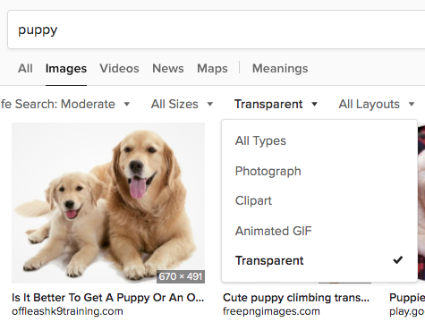
Bridging to Video Games
Find images for your game, and use this Google Draw template to create a Screenshot.
Screenshot must include
Estimates of coordinates for each character.
2 characters that have similar x-coordinates.
2 characters that have similar y-coordinates.
Tip: Find transparent images on DuckDuckGo.

Slide 10
Bridging to Video Games
What games did you come up with?
What are the coordinates of the dog before it gets onscreen?
Why do we make estimates?
What makes a good estimate?
How can we improve our estimation skills?

